Slide 1
Grayson County
William Hays, Joshlyn Javier, Kevin Pham, Nick Zekulin

Slide 2
OUR TEAM
William Hays
Joshlyn Javier
Kevin Pham
Nick Zekulin

Slide 3
TABLE OF CONTENTS
Grayson County Profile
Sales Tax Variable Overview
01
02
Univariate Analysis
Multivariate Analysis
03
04

Slide 4
01
GRAYSON COUNTY
Profile

Slide 5
GRAYSON COUNTY PROFILE
TX County in the Northern suburb of Dallas
Population: 135, 543
Exhibiting growth over the last 12 years
20.6% with Bachelor’s degree or higher
Population concentrated in
Sherman (43,645)
Dennison (24, 479)

Slide 6
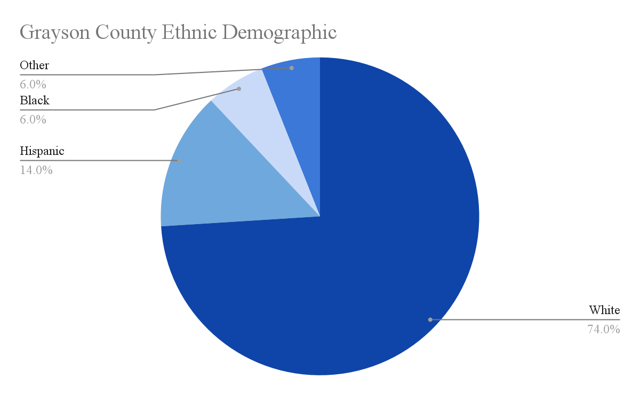
GRAYSON COUNTY PROFILE

Slide 7
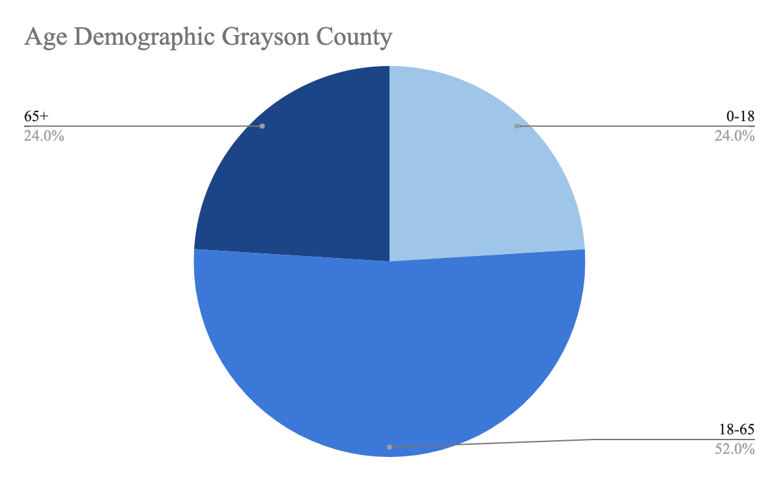
GRAYSON COUNTY AGE DISTRIBUTION

Slide 8
GRAYSON COUNTY ECONOMY
Largest Industries
Healthcare/Education
Retail Trade
Manufacturing
Construction
Major Employers
Texoma Medical Center (4,000)
Tyson (1,750)

Slide 9
02
SALES TAX
Variable Overview

Slide 10
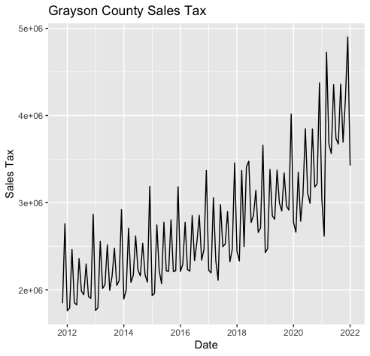
OVERVIEW
Upward Trend
Trough: April
Peak: December
Consistent peaks in: March, June, September, December
Consistent troughs: January, February, April, August, November
Cyclical pattern

Slide 11
03
UNIVARIATE MODEL

Slide 12
UNIVARIATE VS MULTIVARIATE
UNIVARIATE
MULTIVARIATE
Only one variable is varying over time. It is used to describe a type of data which consists of observations on only a single characteristic or attribute.
Multivariate forecasting has more than one time-dependent variable. Each variable depends not only on its past values, but has some dependency on other values which is used to forecast future values.

Slide 13
TESTS UTILIZED
ETS
ARIMA
VAR
Exponential smoothing is a way to smooth out data for presentations or to make forecasts. If you don't have a clear pattern you can use exponential smoothing to forecast.
An autoregressive integrated moving average, or ARIMA, is a statistical analysis model that uses time series data to either better understand the data set or to predict future trends. A statistical model is autoregressive if it predicts future values based on past values.
Vector autoregression is a statistical model used to capture the relationship between multiple quantities as they change over time. VAR models generalize the single-variable (univariate) autoregressive model by allowing for multivariate time series..

Slide 14
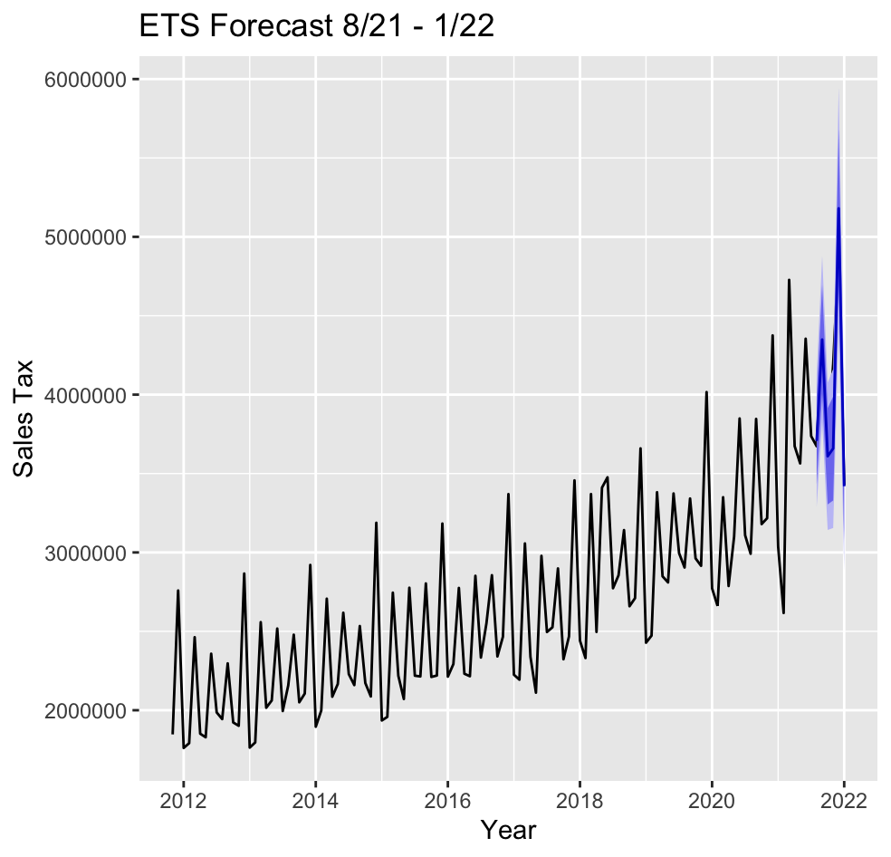
ETS Forecasts
8/21 - 1/22
The six-month ahead forecast for the ETS model is shown below in Figure 2.1.

Slide 15
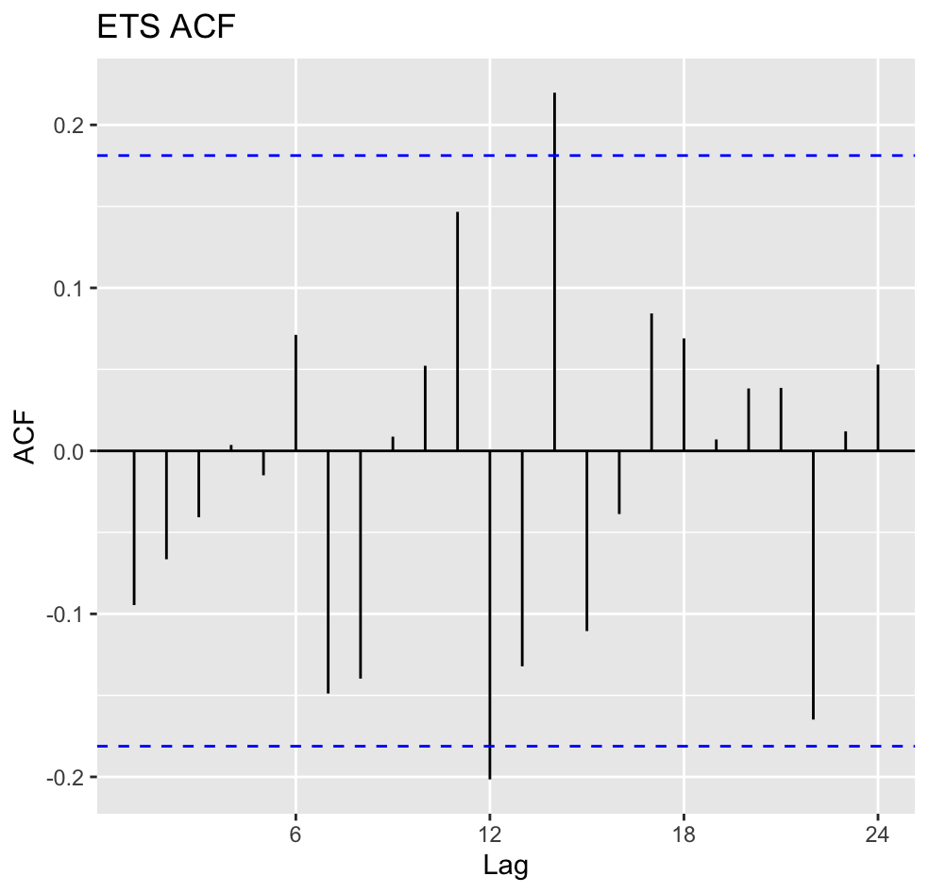
ETS ACF
The plot shows a mean that is close to zero and no extreme correlation in the series.

Slide 16
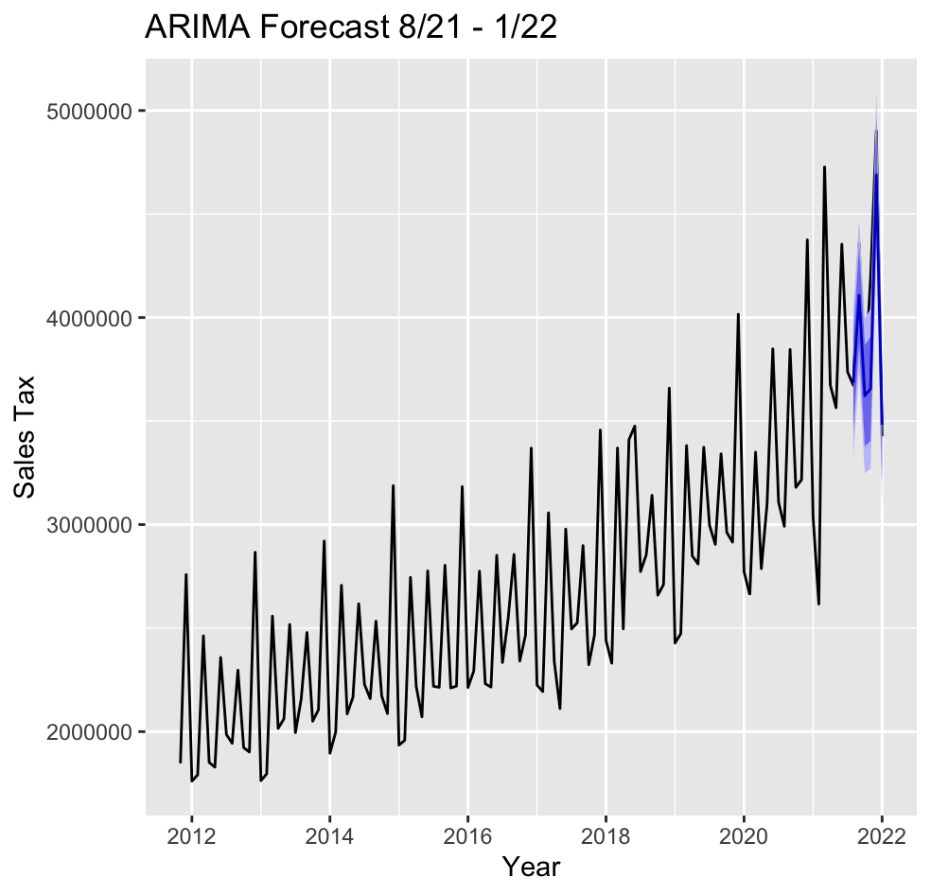
ARIMA Forecasts
8/21 - 1/22
Very similar to the ETA Forecasts

Slide 17
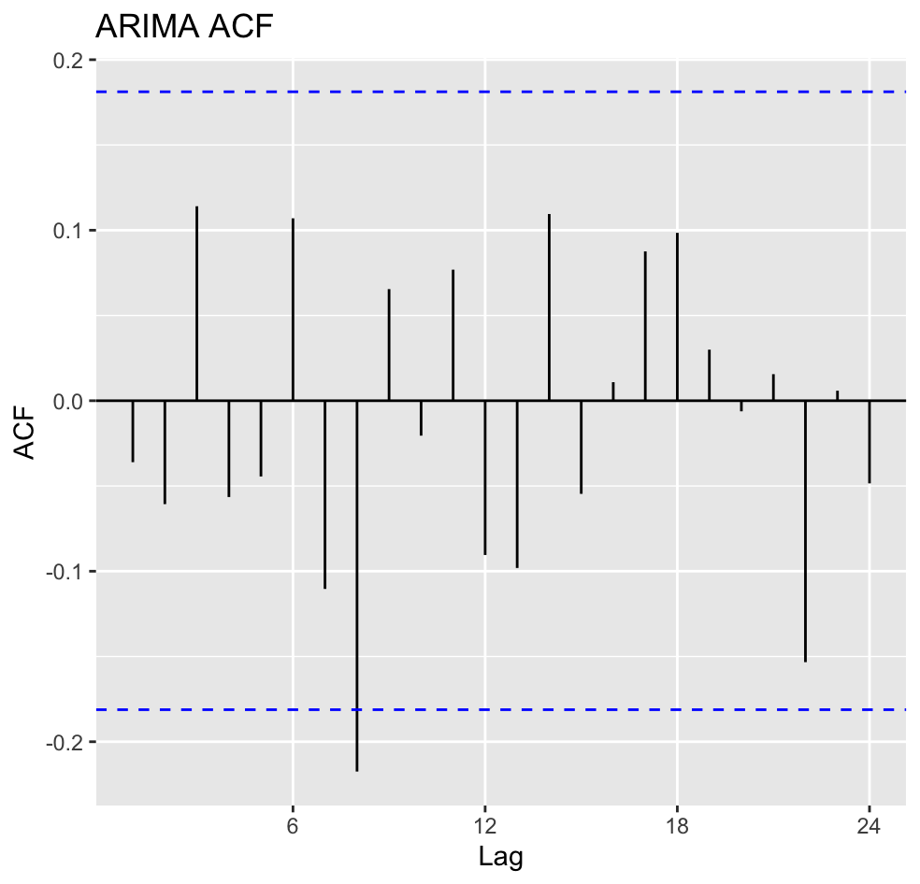
ARIMA ACF
A mean of the residuals near zero with no correlation and only one extreme outlier. The ARIMA model appears to be a more accurate fit of the data, though this does not necessarily mean that it will be a better predictor of future values.

Slide 18
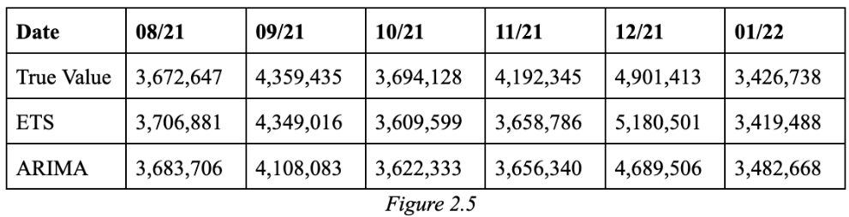
COMPARISON
A comparison of the forecasted values from each model for the final six months of data compared to their actual values.

Slide 19
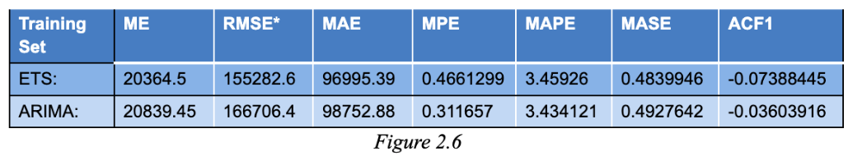
COMPARISON
The accuracy measures of each model along with lower AIC, AICc, and BIC for ETS model

Slide 20
Preferred model is:
ETS Model
ETS model provided a better forecast of the values of the last six months of data within the series.

Slide 21
Two additional forecasts were created based on the training data. Using both the ETS and ARIMA models again, two series of 6 one-step-ahead forecasts were created for the last six months of given data.

Slide 22
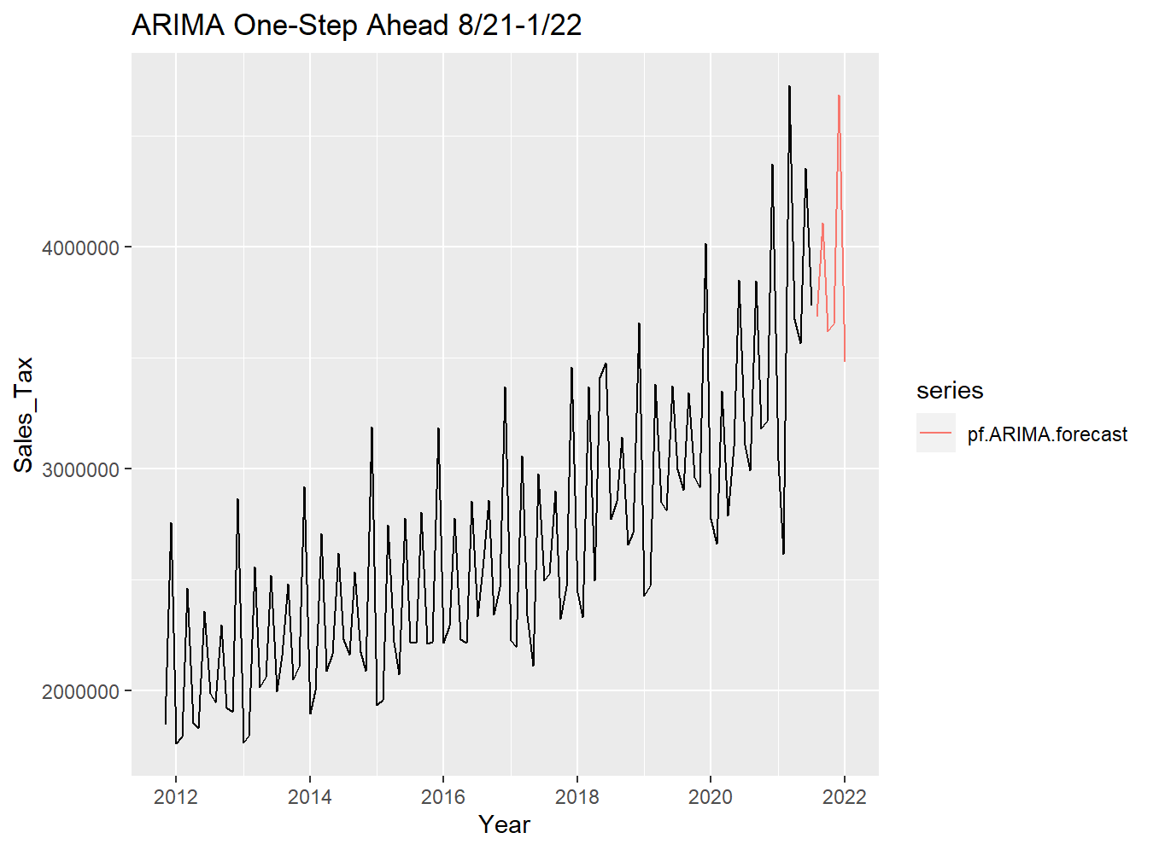
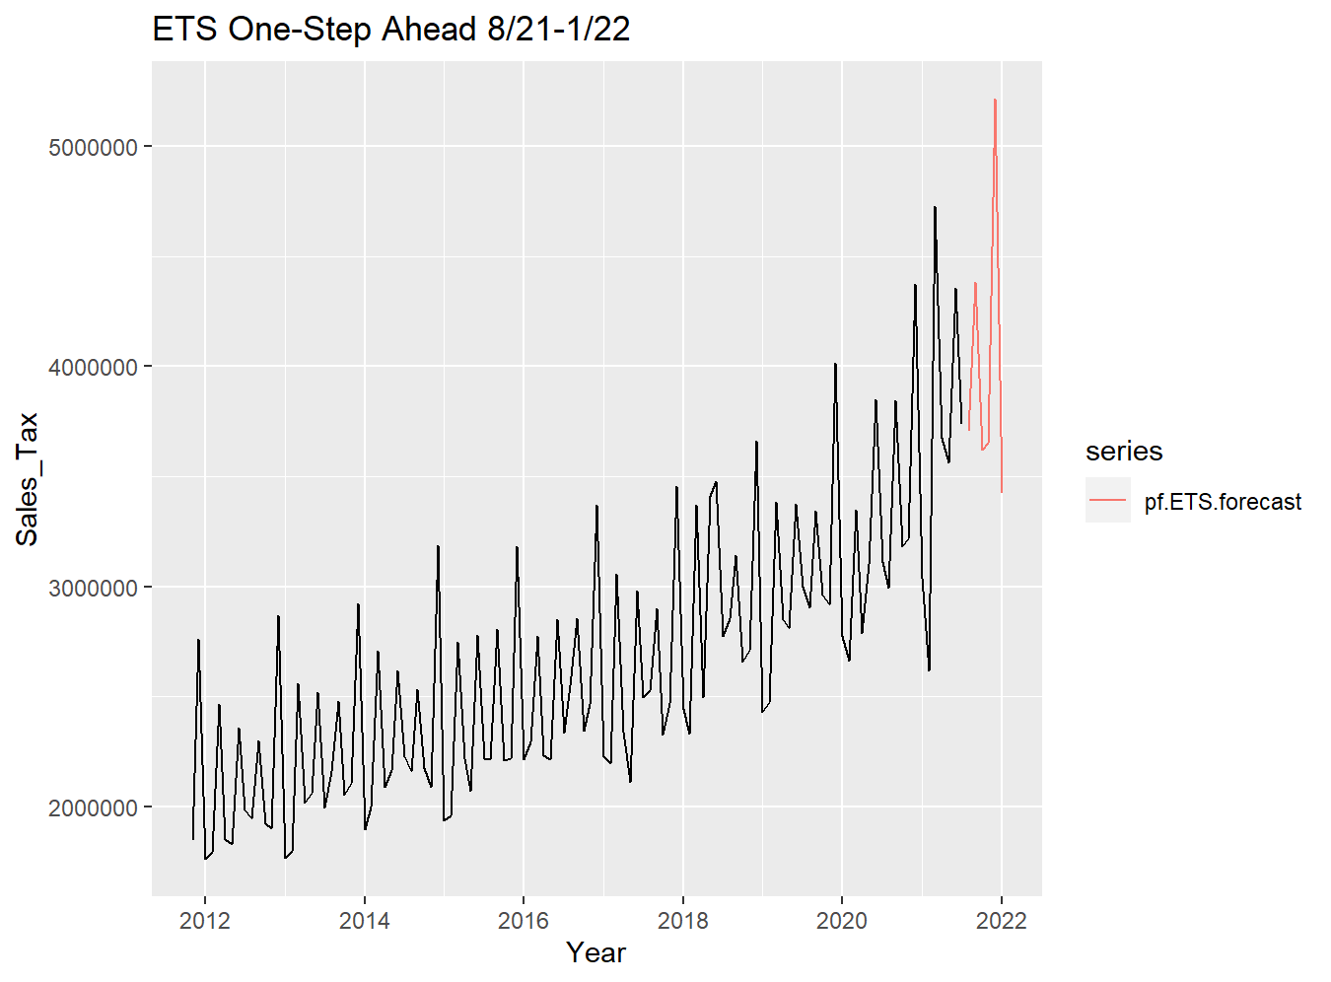
ETS and Arima One-Step Ahead 8/21 - 1/22

Slide 23
ARIMA ACF
A mean of the residuals near zero with no correlation and only one extreme outlier. The ARIMA model appears to be a more accurate fit of the data, though this does not necessarily mean that it will be a better predictor of future values.

Slide 24
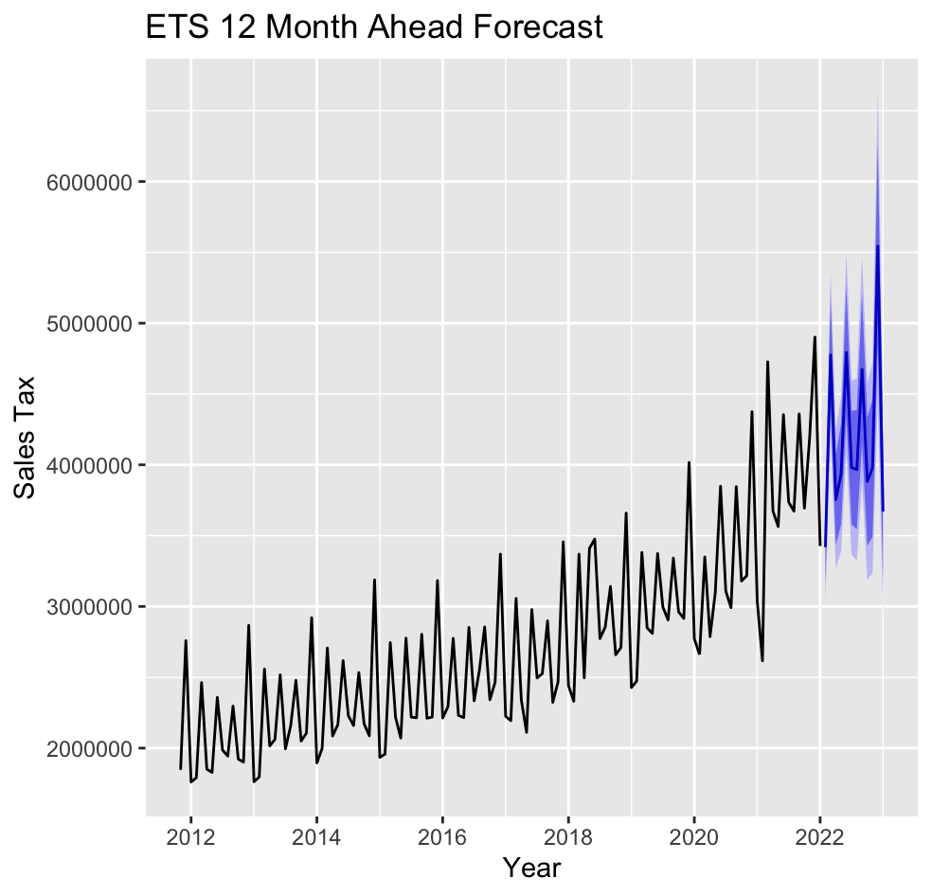
ETS 12 MONTH AHEAD FORECAST
From the forecast, the upward trend is expected to continue although apparently slightly less steep than previously. A similar large spike in Sales Tax collection is expected in December of 2022, predicted to be around $5.5m. The seasonality and trend of the series are forecasted to continue.

Slide 25
ETS 12 MONTH AHEAD FORECAST
2021 Total: $46,530,180
2022 Total: $50,131,893
$3,601,702 Increase
7.74% Increase YoY

Slide 26
04
MULTIVARIATE
MODEL

Slide 27
Time Series Variables in VAR
Sales Tax Collections
Unemployment
Rate
Civilian Labor Force Population.

Slide 28
VAR
Monthly from November 2011 to January 2022, providing 123 data points.
Expected that the civilian labor force and the Sales Tax collections would be positively correlated
As more people enter the workforce, more income is generated. Most of this income will be spent within Grayson County leading to higher collections.

Slide 29
VAR
Expected that the unemployment rate and Sales Tax collections would be negatively correlated.
As the unemployment rate increases, there is a larger amount of citizens that are spending a decreased wage from being out of a job. This decreased spending should be negatively correlated with the Sales Tax collections.

Slide 30
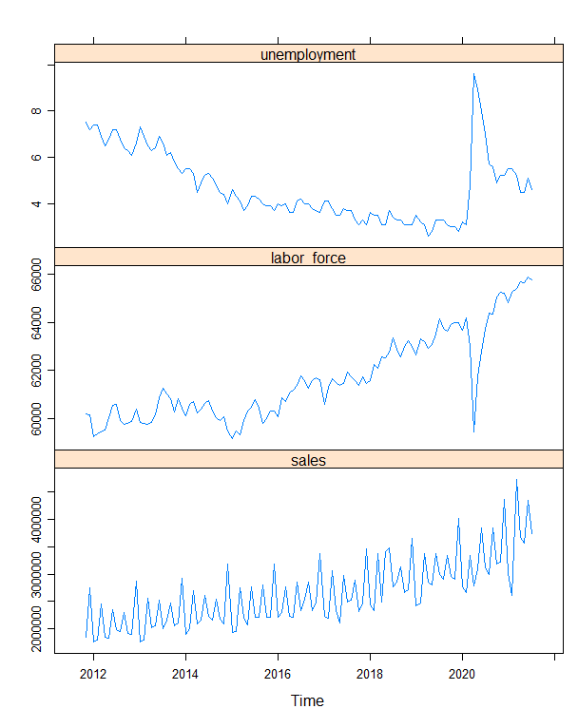
Time Series Plots
An obvious point to note in the plots of both the unemployment rate and civilian labor force are the large spikes in 2020, as a result of the COVID-19 pandemic.

Slide 31
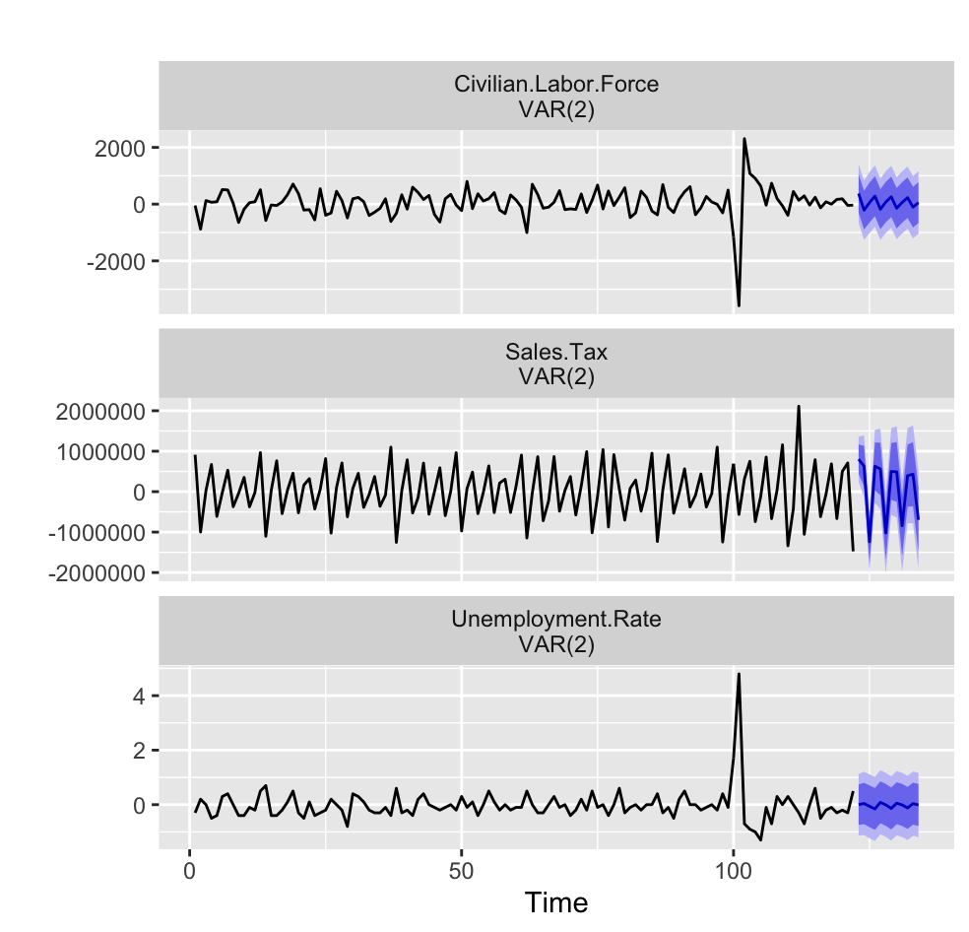
Stationary Forecast Plots for Each of the Variables
Each variable was differenced once to make them stationary and a VAR model was constructed with two lags. A 12-month ahead forecast was made from February 2022 to January 2023.

Slide 32
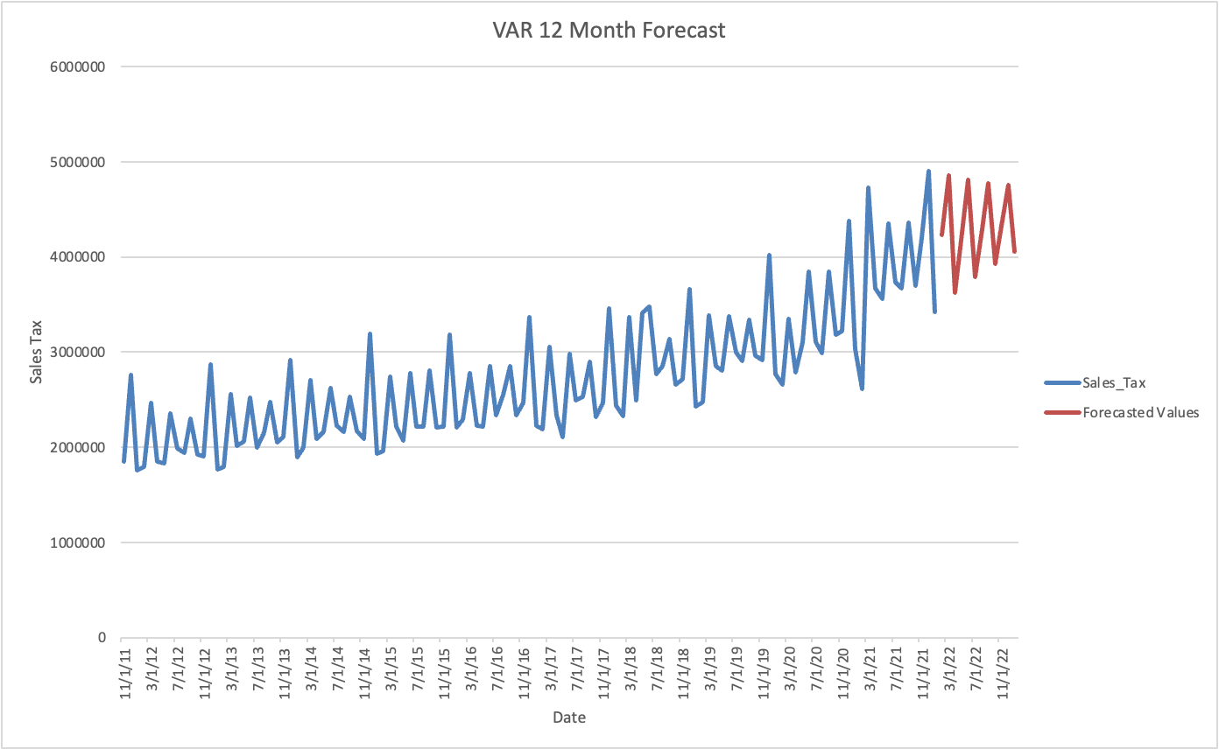
VAR 12 Month Forecast
2021 Total: $46,530,180
2022 Total: $47,631709
$1,101,528 Increase
2.37% Increase YoY

Slide 33
VAR 12 Month Forecast
The results of the VAR model were not significant (p = 0.146). Therefore, the ETS model is the preferred model to be used to predict the next 12 months of data.

Slide 34
THANKS
Do you have any questions?

